Slide 1
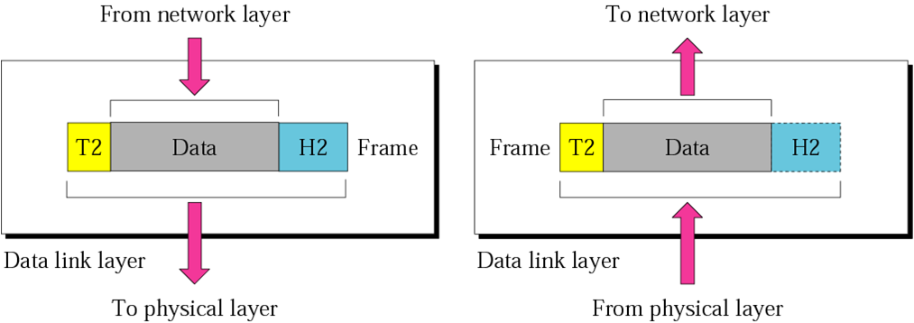
DATA LINK LAYER
The data link layer is responsible for moving frames from one hop (node) to the next.

Slide 2
The two main functions of the data link layer are data link control and media access control.
The first, data link control, deals with the design and procedures for communication between two adjacent nodes: node-to-node communication.
Data link control functions include framing, flow and error control, and software implemented protocols that provide smooth and reliable transmission of frames between nodes.

Slide 3
Data Link Control
To implement data link control, we need protocols. Each protocol is a set of rules that need to be implemented in software and run by the two nodes involved in data exchange at the data link layer.
We discuss five protocols: two for noiseless (ideal) channels and three for noisy (real) channels.

Slide 4
FRAMING
The data link layer needs to pack bits into frames, so that each frame is distinguishable from another. Our postal system practices a type of framing. The simple act of inserting a letter into an envelope separates one piece of information from another; the envelope serves as the delimiter.
Topics discussed in this section:
Fixed-Size Framing Variable-Size Framing

Slide 5
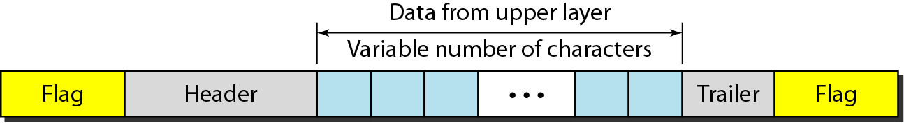
Figure 11.1 A frame in a character-oriented protocol

Slide 6
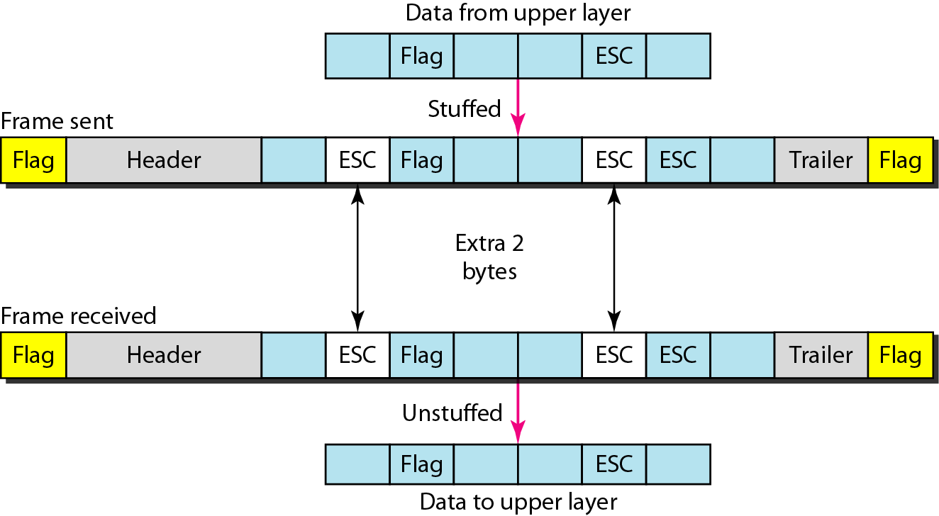
Figure 11.2 Byte stuffing and unstuffing

Slide 7

Note
Byte stuffing is the process of adding 1 extra byte whenever there is a flag or escape character in the text.

Slide 8
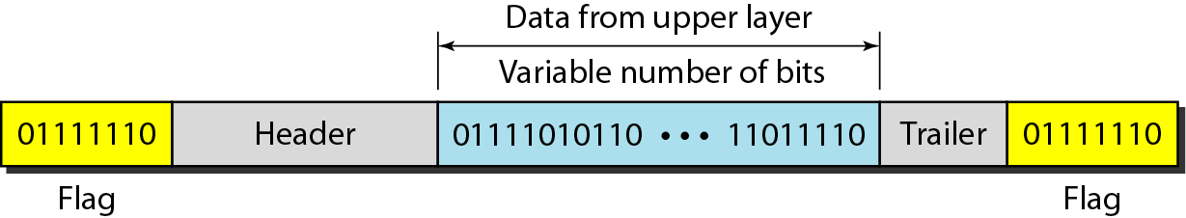
Figure 11.3 A frame in a bit-oriented protocol

Slide 9
Note
Bit stuffing is the process of adding one extra 0 whenever five consecutive 1s follow a 0 in the data, so that the receiver does not mistake
the pattern 0111110 for a flag.

Slide 10
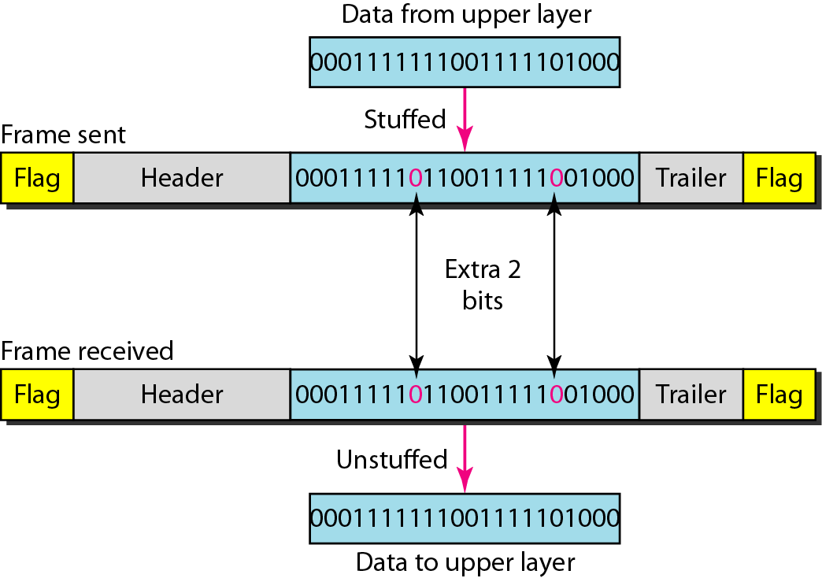
Figure 11.4 Bit stuffing and unstuffing

Slide 11
11-2 FLOW AND ERROR CONTROL
The most important responsibilities of the data link layer are flow control and error control. Collectively, these functions are known as data link control.
Topics discussed in this section:
Flow Control Error Control

Slide 12
Note
Flow control refers to a set of procedures used to restrict the amount of data
that the sender can send before
waiting for acknowledgment.

Slide 13
Note
Error control in the data link layer is based on automatic repeat request, which is the retransmission of data.

Slide 14
11-3 PROTOCOLS
Now let us see how the data link layer can combine framing, flow control, and error control to achieve the delivery of data from one node to another. The protocols are normally implemented in software by using one of the common programming languages. To make our discussions language-free, we have written in pseudocode a version of each protocol that concentrates mostly on the procedure instead of delving into the details of language rules.

Slide 15
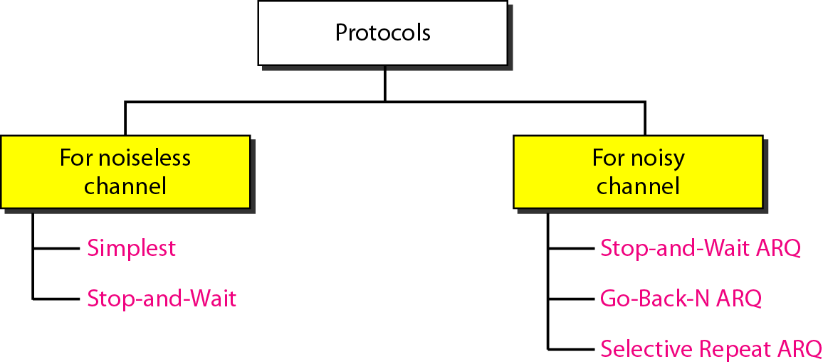
Figure 11.5 Taxonomy of protocols discussed in this chapter

Slide 16
11-4 NOISELESS CHANNELS
Let us first assume we have an ideal channel in which no frames are lost, duplicated, or corrupted. We introduce two protocols for this type of channel.
Topics discussed in this section:
Simplest Protocol Stop-and-Wait Protocol

Slide 17
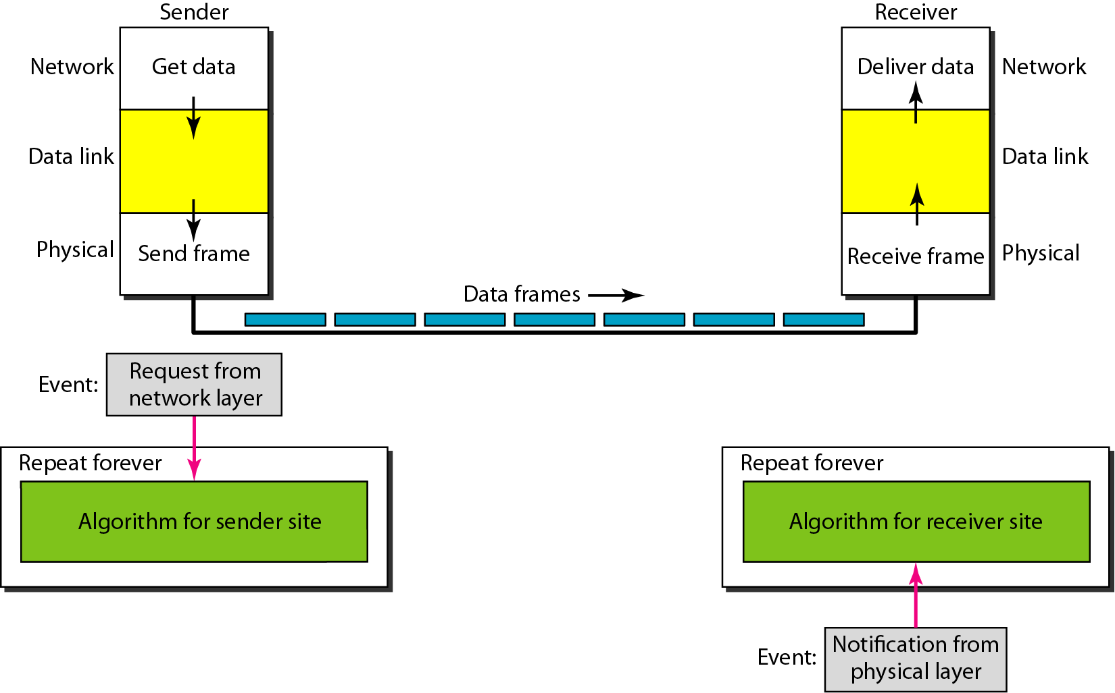
Figure 11.6 The design of the simplest protocol with no flow or error control

Slide 18
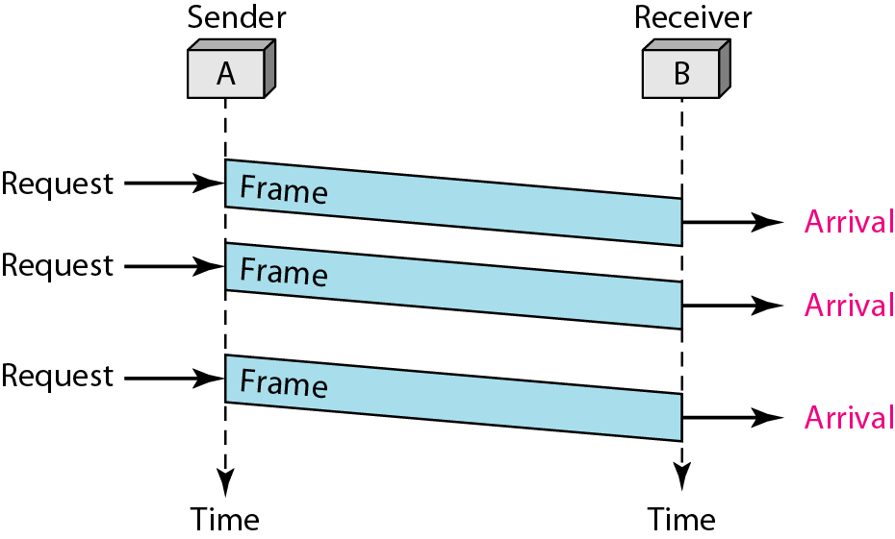
Figure 11.7 Flow diagram for Simplest Protocol

Slide 19
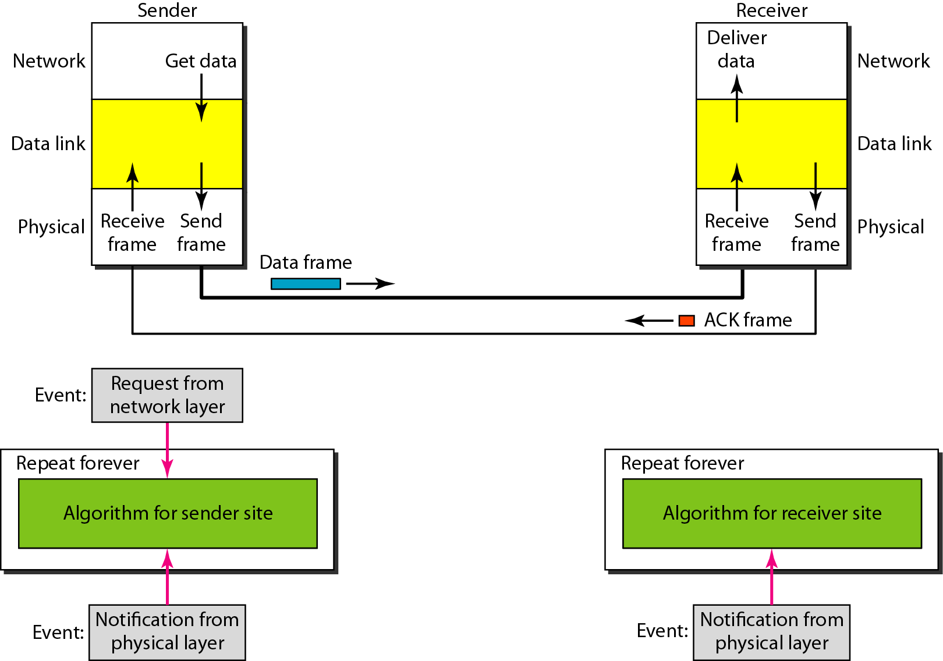
Figure 11.8 Design of Stop-and-Wait Protocol

Slide 20
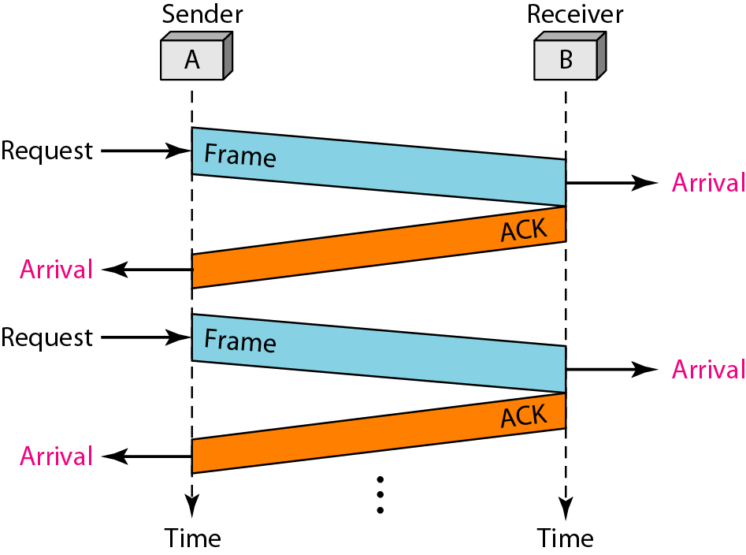
Figure 11.9 Flow diagram for Stop and Wait Protocol

Slide 21
11-5 NOISY CHANNELS
Although the Stop-and-Wait Protocol gives us an idea of how to add flow control to its predecessor, noiseless channels are nonexistent. We discuss three protocols in this section that use error control.
Topics discussed in this section:
Stop-and-Wait Automatic Repeat Request Go-Back-N Automatic Repeat Request Selective Repeat Automatic Repeat Request

Slide 22
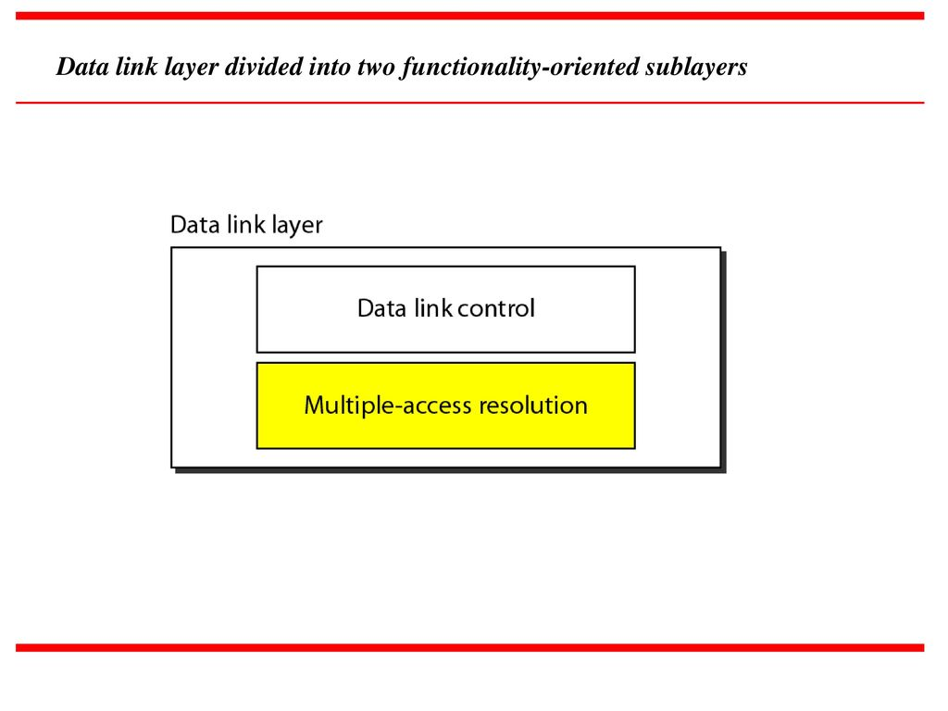
Multiple Access
We can consider the data link layer as two sublayers. The upper sublayer is responsible
for data link control, and the lower sublayer is responsible for resolving access to the
shared media. If the channel is dedicated, we do not need the lower sublayer

Slide 23
The upper sublayer that is responsible for flow and error control is called the logical link control (LLC) layer;
the lower sublayer that is mostly responsible for multiple access resolution is called the media access control (MAC) layer.
When nodes or stations are connected and use a common link, called a multipoint or broadcast link, we need a multiple-access protocol to coordinate access to the link.

Slide 24
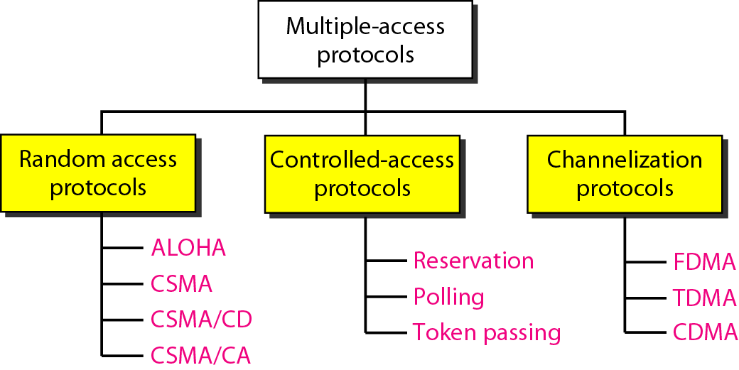
Figure 12.2 Taxonomy of multiple-access protocols discussed in this chapter

Slide 25
12-1 RANDOM ACCESS
In random access or contention methods, no station is superior to another station and none is assigned the control over another. No station permits, or does not permit, another station to send. At each instance, a station that has data to send uses a procedure defined by the protocol to make a decision on whether or not to send.
Topics discussed in this section:
ALOHA Carrier Sense Multiple Access
Carrier Sense Multiple Access with Collision Detection
Carrier Sense Multiple Access with Collision Avoidance

Slide 26
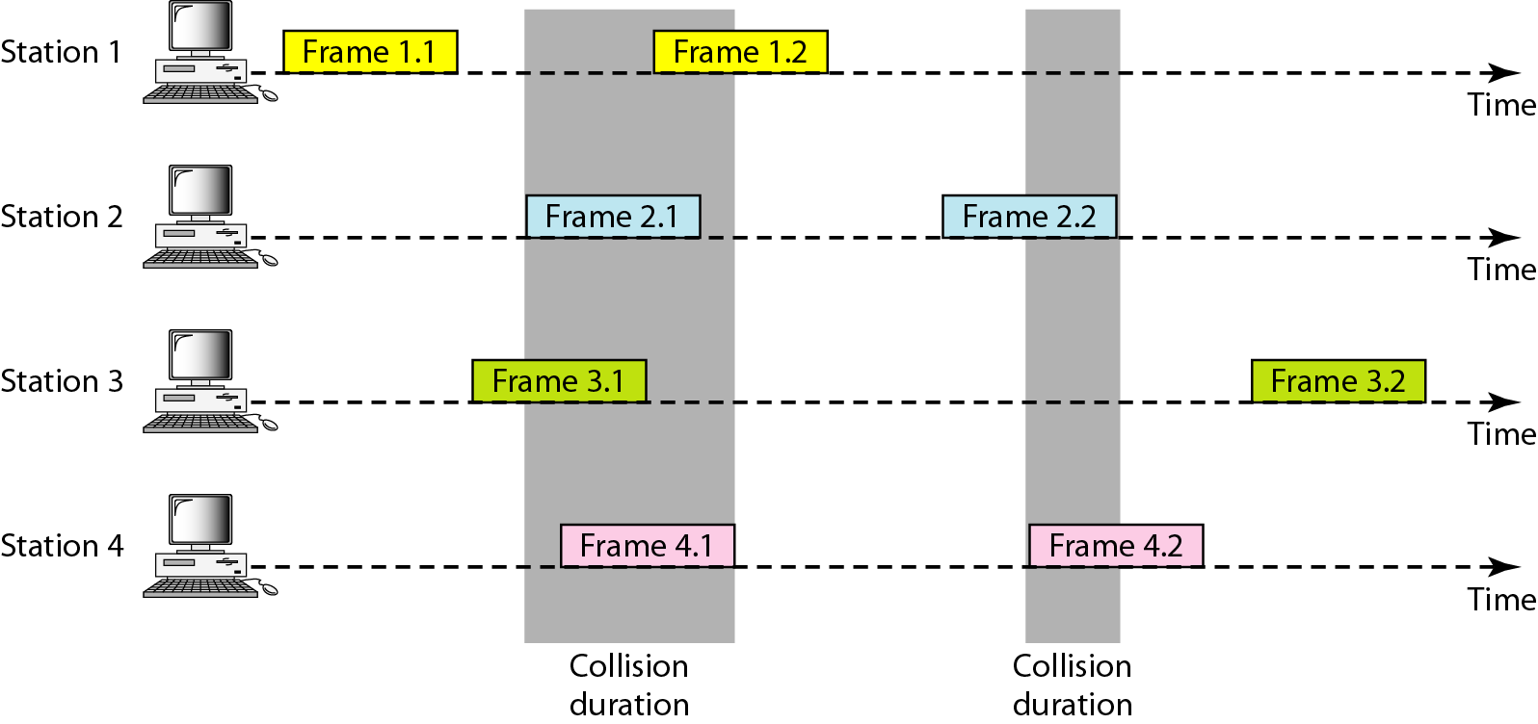
Figure 12.3 Frames in a pure ALOHA network

Slide 27
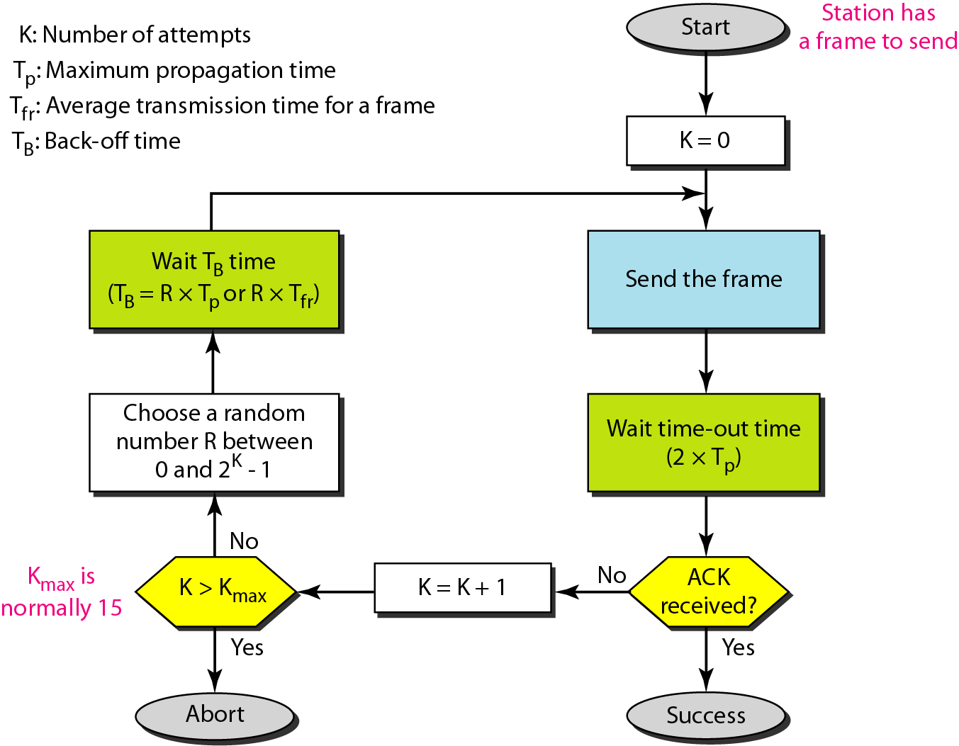
Figure 12.4 Procedure for pure ALOHA protocol

Slide 28
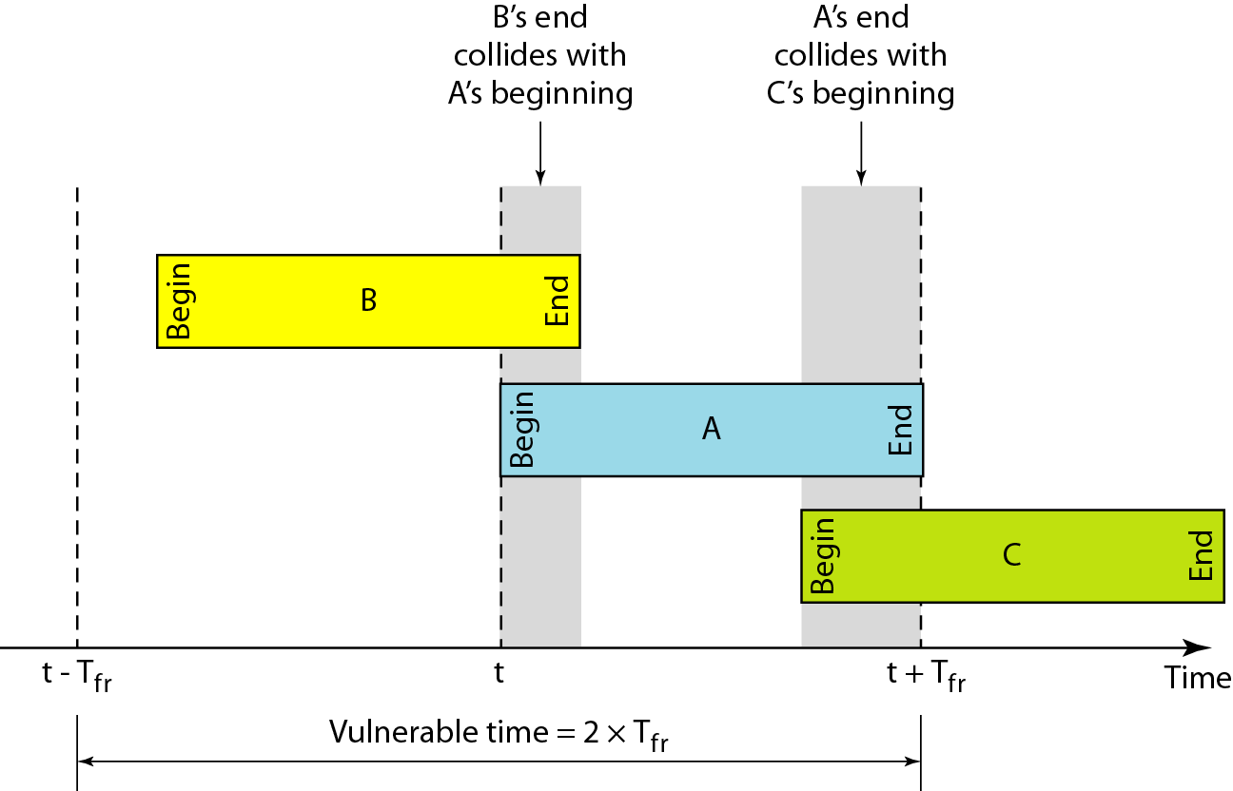
Figure 12.5 Vulnerable time for pure ALOHA protocol

Slide 29
Note
The throughput for pure ALOHA is S = G × e ^{−2G} .
The maximum throughput
S_{max} = 0.184 when G= (1/2).

Slide 30
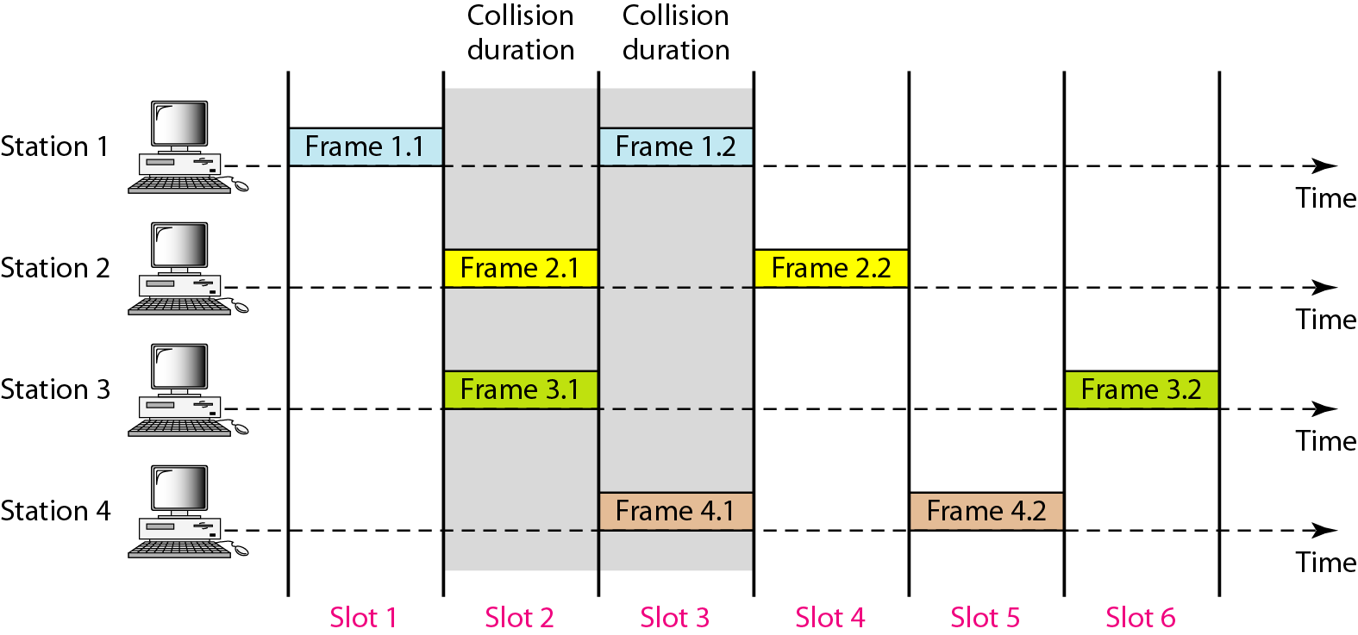
Figure 12.6 Frames in a slotted ALOHA network

Slide 31
Note
The throughput for slotted ALOHA is S = G × e^{−G} .
The maximum throughput S_{max} = 0.368 when G = 1.

Slide 32
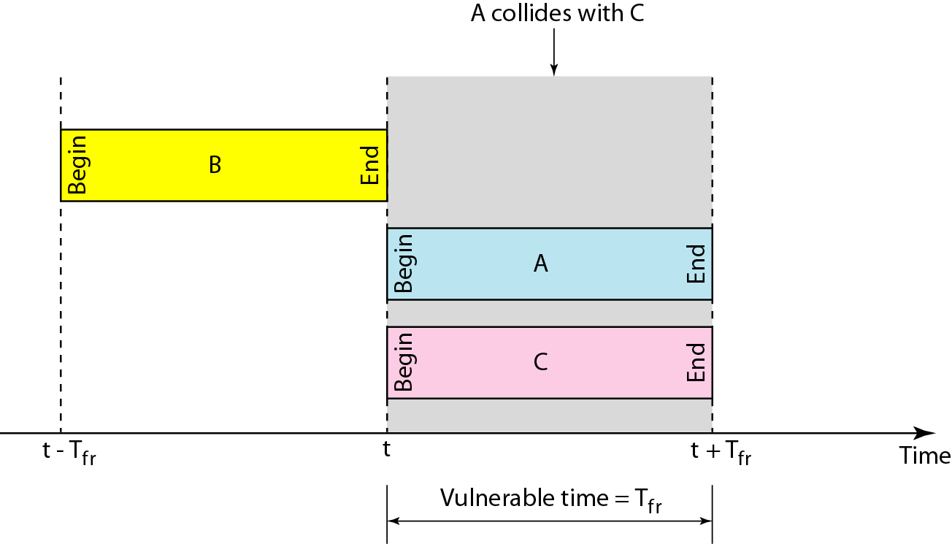
Figure 12.7 Vulnerable time for slotted ALOHA protocol

Slide 33
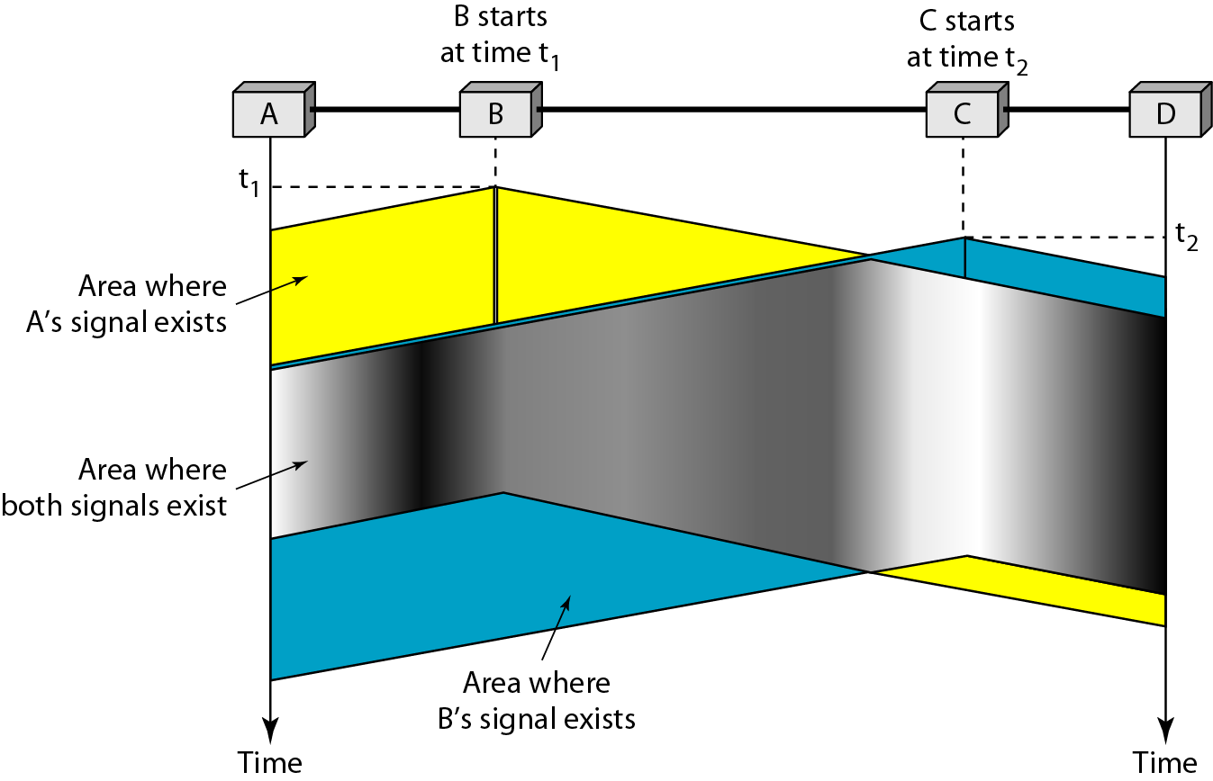
Figure 12.8 Space/time model of the collision in CSMA

Slide 34
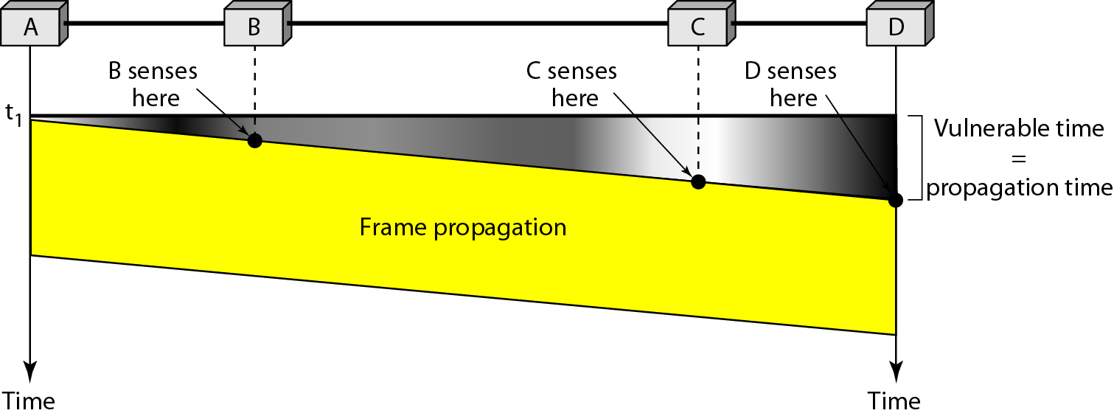
Figure 12.9 Vulnerable time in CSMA

Slide 35
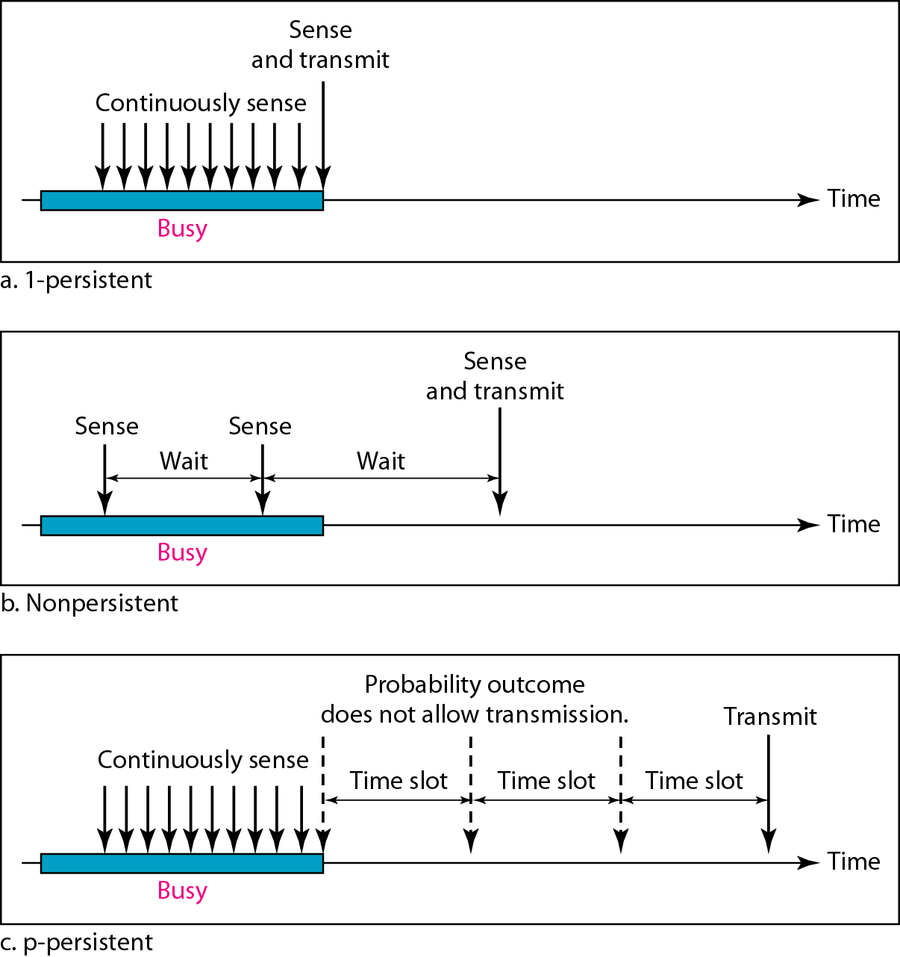
Figure 12.10 Behavior of three persistence methods

Slide 36
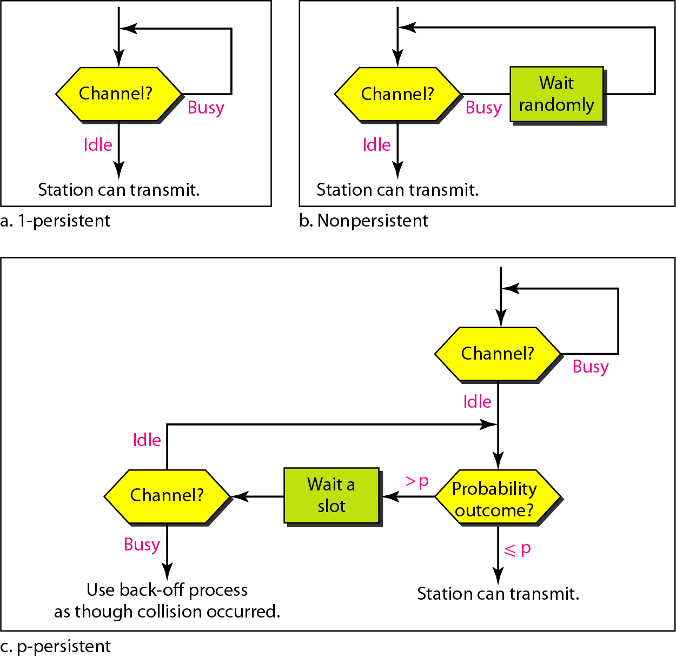
Figure 12.11 Flow diagram for three persistence methods

Slide 37
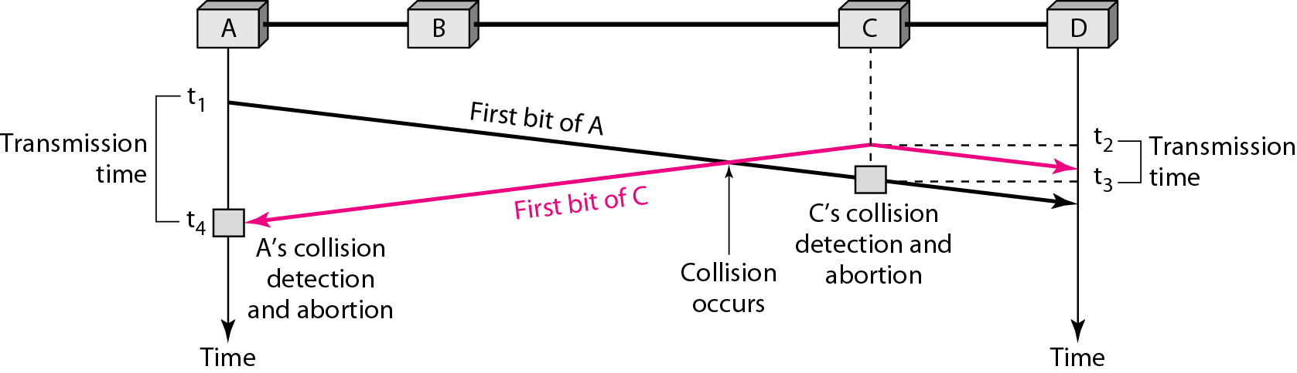
Figure 12.12 Collision of the first bit in CSMA/CD

Slide 38
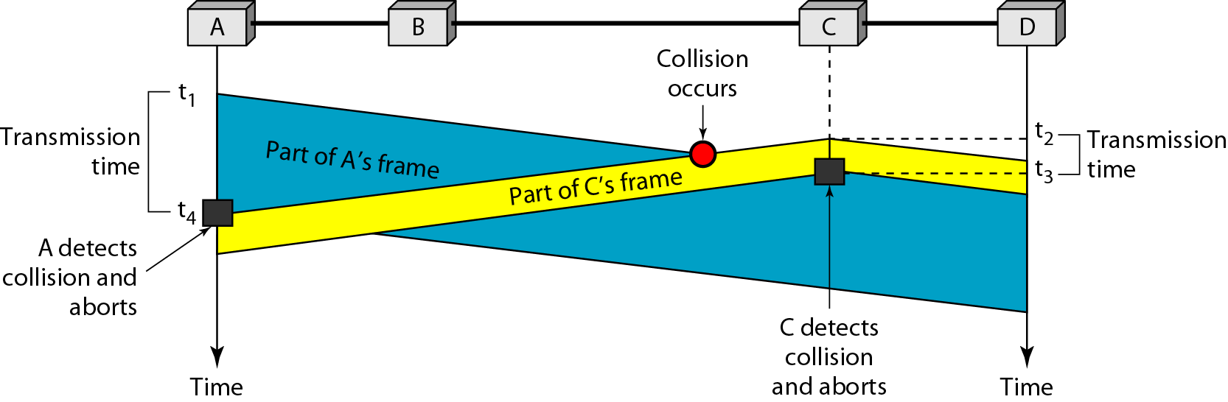
Figure 12.13 Collision and abortion in CSMA/CD

Slide 39
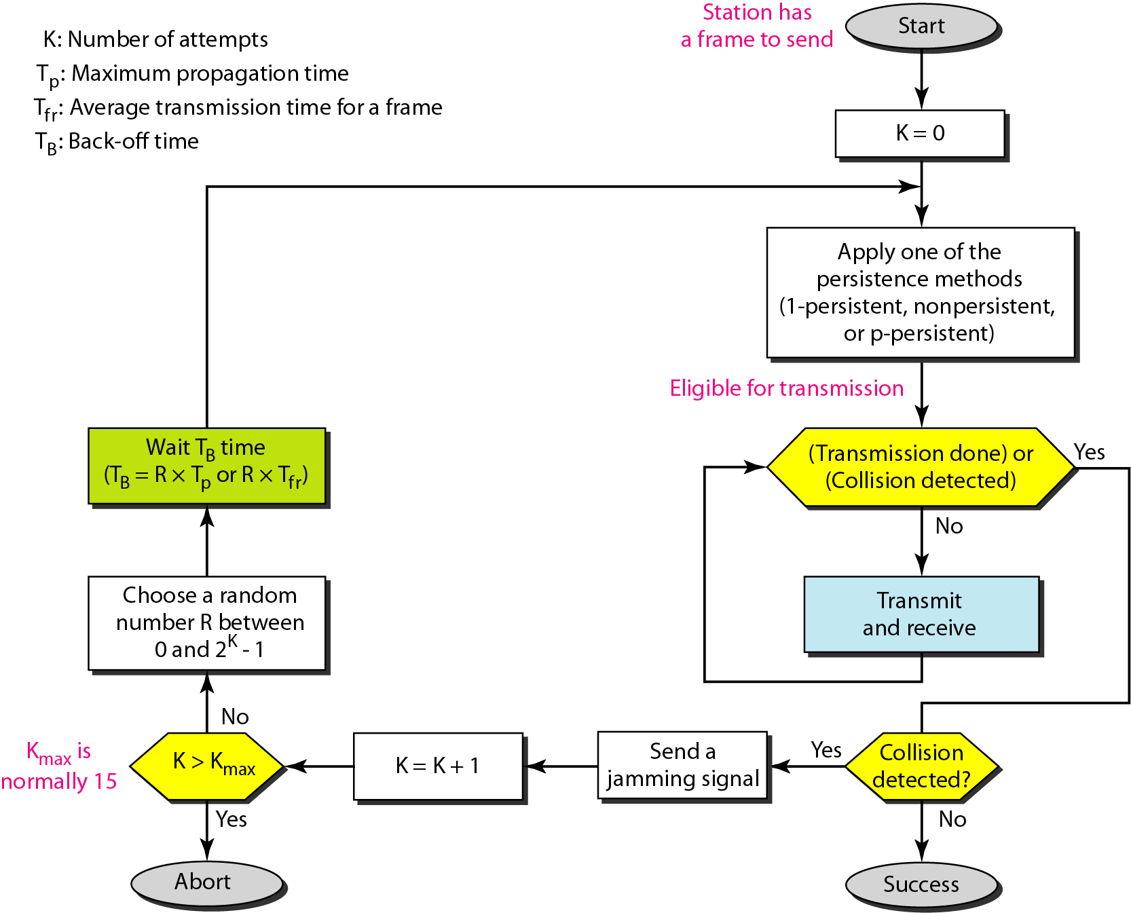
Figure 12.14 Flow diagram for the CSMA/CD

Slide 40
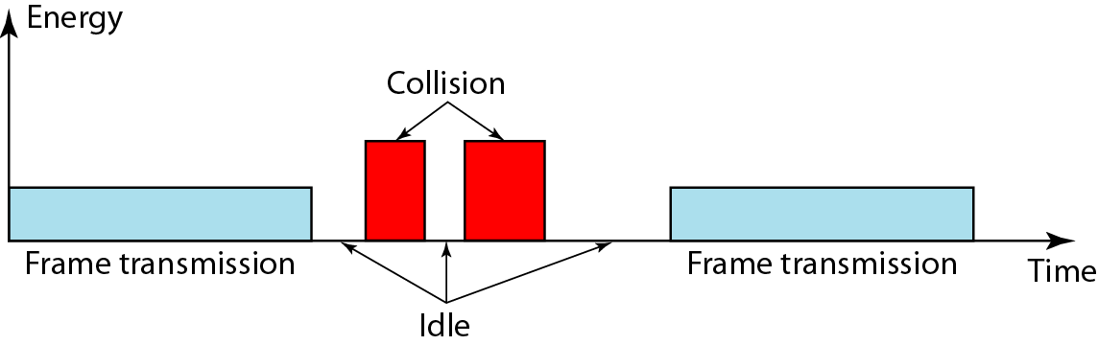
Figure 12.15 Energy level during transmission, idleness, or collision

Slide 41
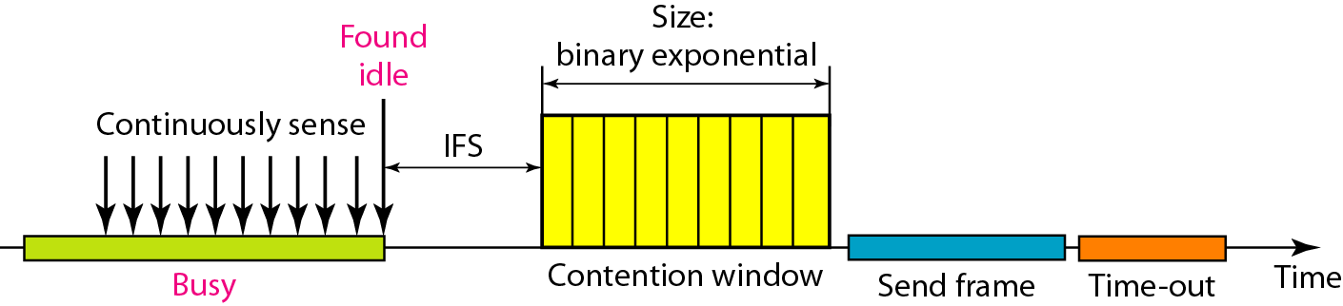
Figure 12.16 Timing in CSMA/CA

Slide 42
Note
In CSMA/CA, the IFS can also be used to define the priority of a station or a frame.

Slide 43
Note
In CSMA/CA, if the station finds the channel busy, it does not restart the timer of the contention window;
it stops the timer and restarts it when the channel becomes idle.

Slide 44
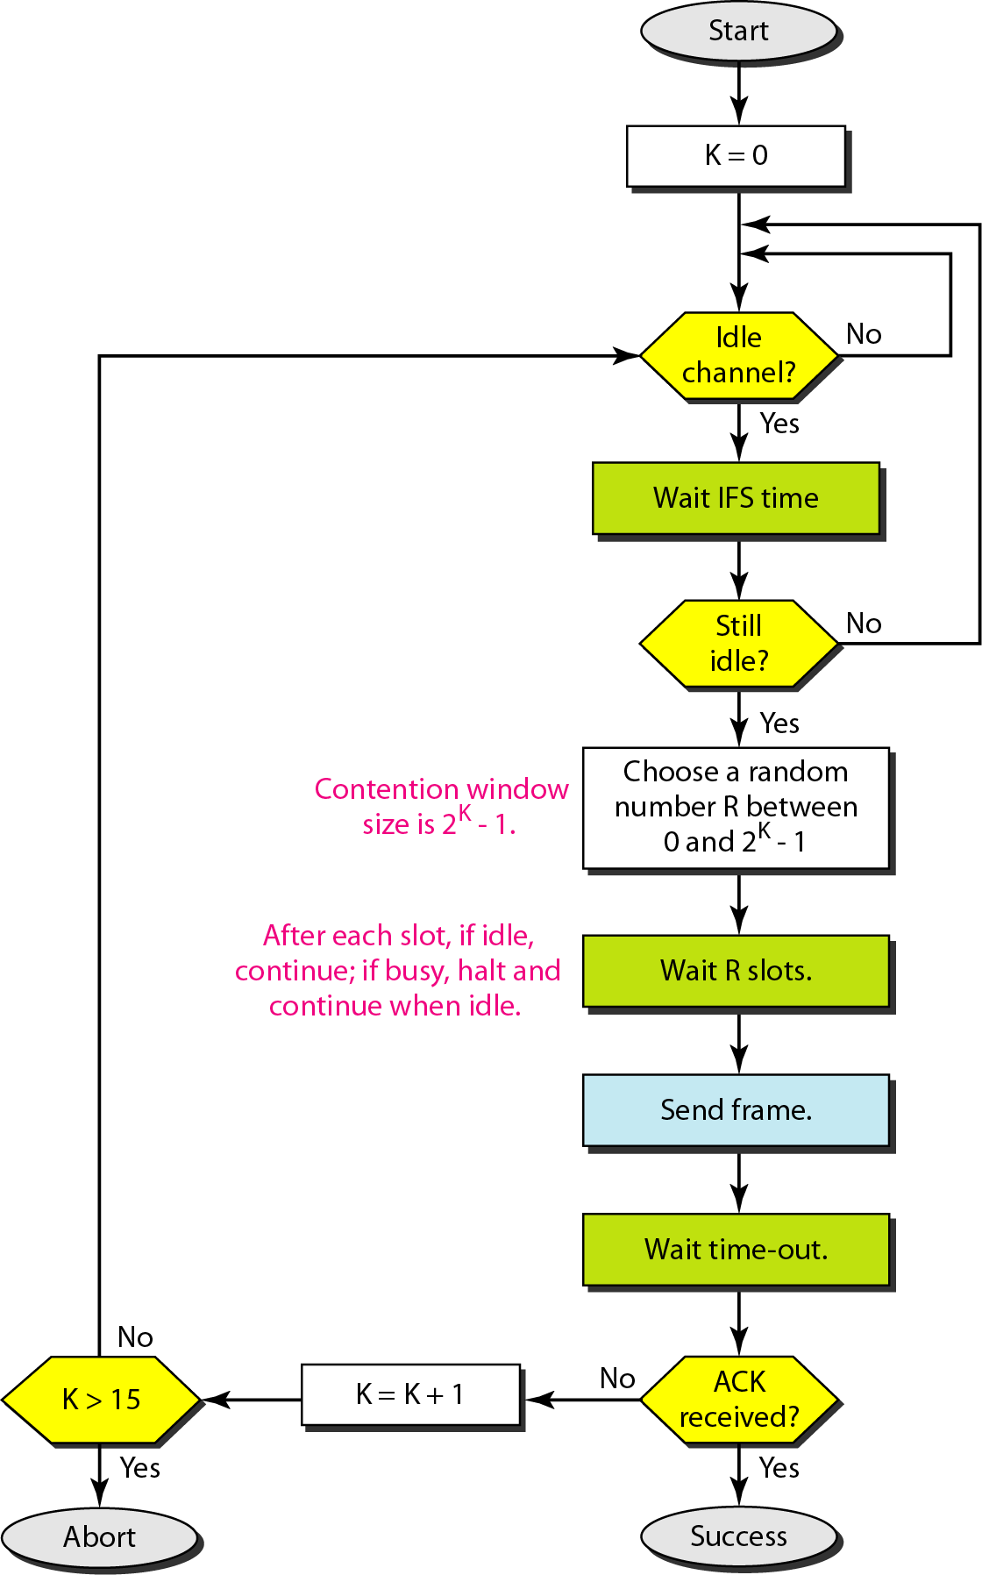
Figure 12.17 Flow diagram for CSMA/CA

Slide 45
12-2 CONTROLLED ACCESS
In controlled access, the stations consult one another to find which station has the right to send. A station cannot send unless it has been authorized by other stations. We discuss three popular controlled-access methods.
Topics discussed in this section:
Reservation Polling Token Passing

Slide 46
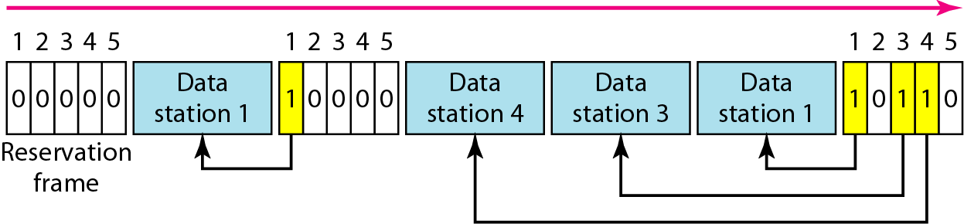
Figure 12.18 Reservation access method

Slide 47
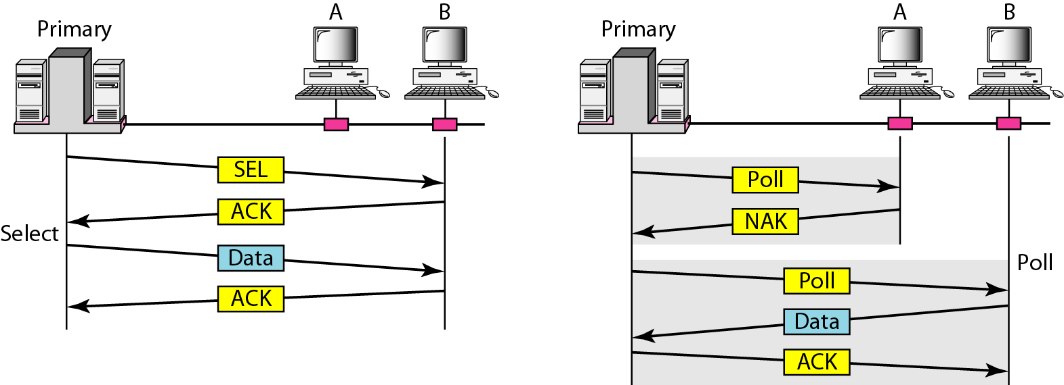
Figure 12.19 Select and poll functions in polling access method

Slide 48
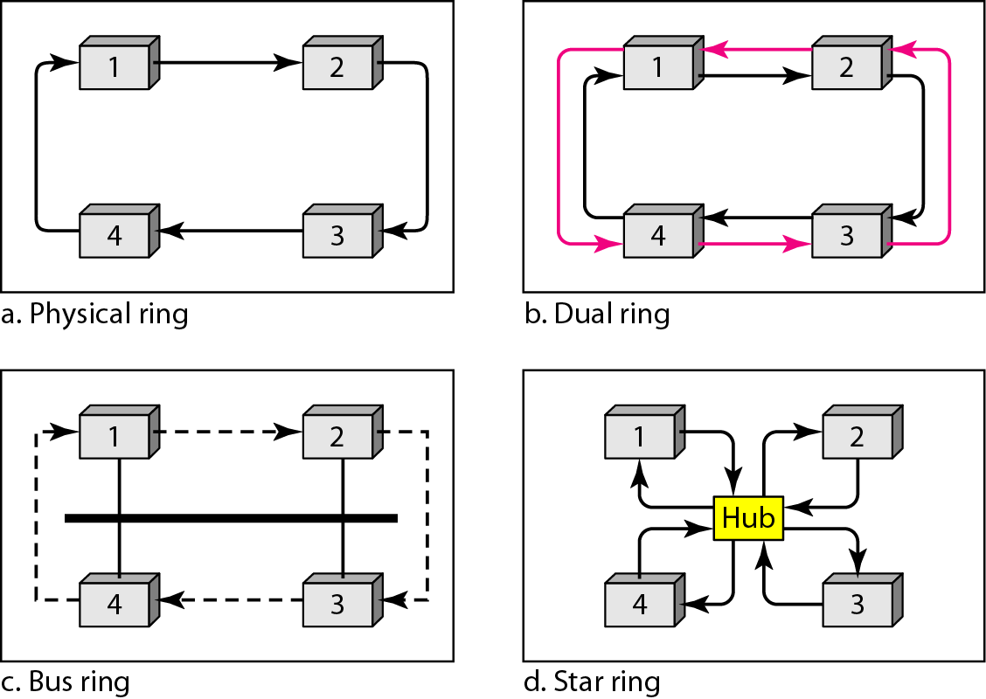
Figure 12.20 Logical ring and physical topology in token-passing access method

Slide 49
12-3 CHANNELIZATION
Channelization is a multiple-access method in which the available bandwidth of a link is shared in time, frequency, or through code, between different stations. In this section, we discuss three channelization protocols.
Topics discussed in this section:
Frequency-Division Multiple Access (FDMA) Time-Division Multiple Access (TDMA)
Code-Division Multiple Access (CDMA)

Slide 50
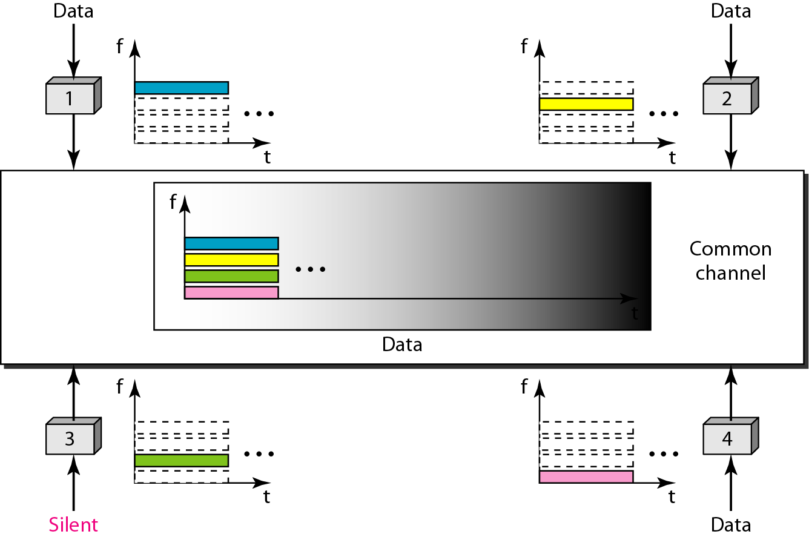
Figure 12.21 Frequency-division multiple access (FDMA)

Slide 51
Note
In FDMA, the available bandwidth of the common channel is divided into bands that are separated by guard bands.

Slide 52
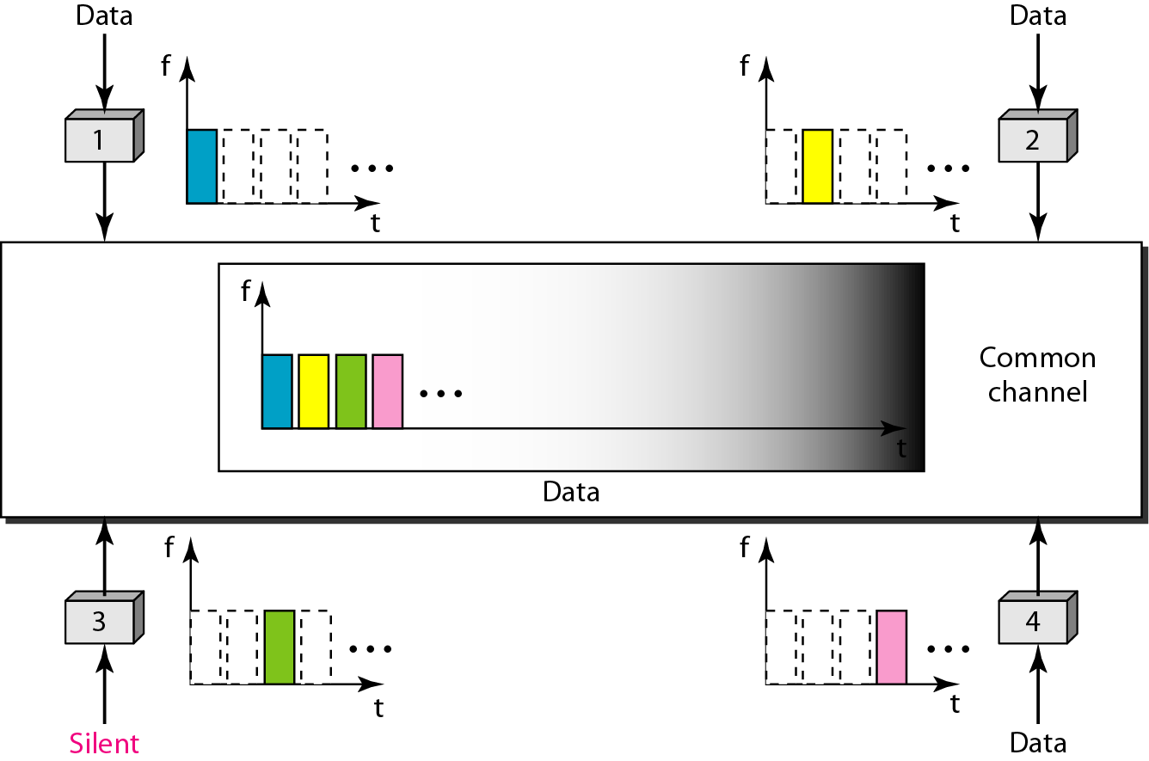
Figure 12.22 Time-division multiple access (TDMA)

Slide 53
Note
In TDMA, the bandwidth is just one channel that is timeshared between different stations.

Slide 54
Note
In CDMA, one channel carries all transmissions simultaneously.

Slide 55
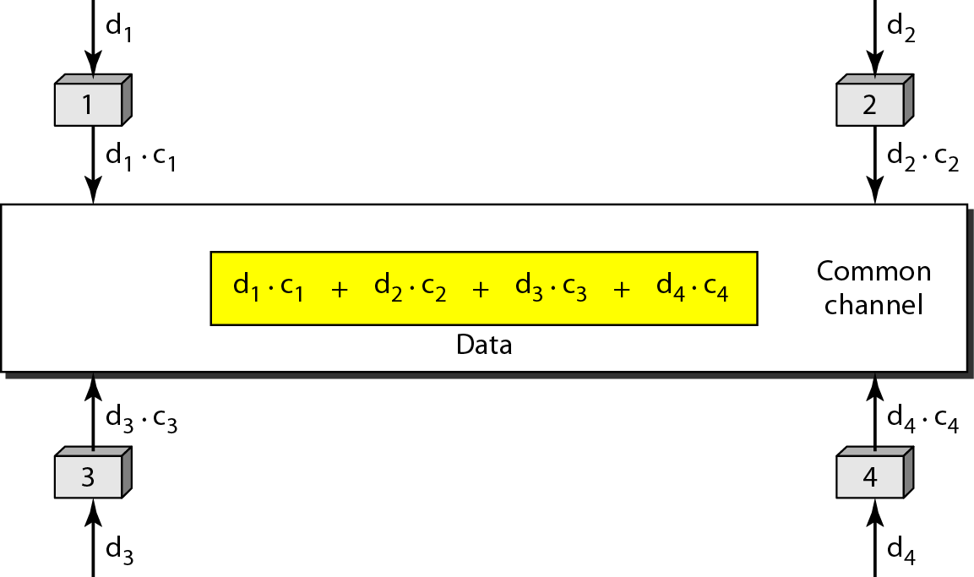
Figure 12.23 Simple idea of communication with code

Slide 56
Figure 12.24 Chip sequences

Slide 57
Figure 12.25 Data representation in CDMA

Slide 58
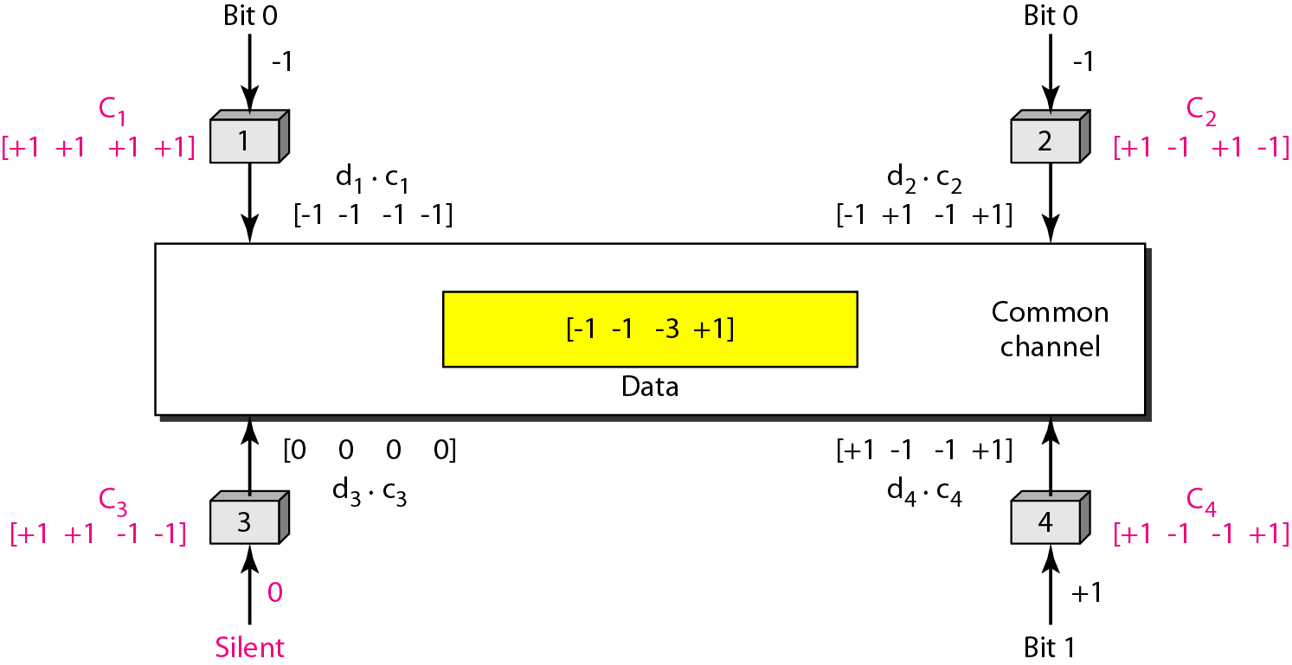
Figure 12.26 Sharing channel in CDMA

Slide 59
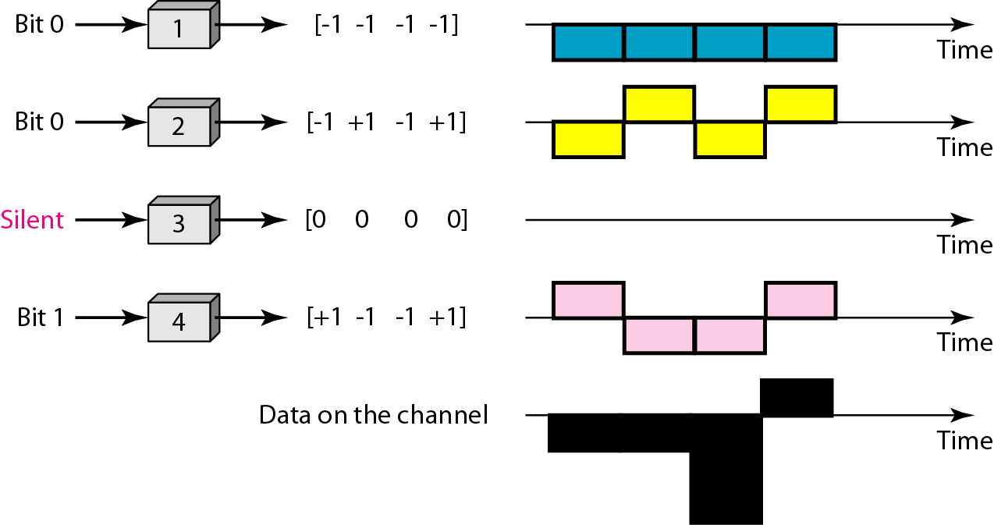
Figure 12.27 Digital signal created by four stations in CDMA

Slide 60
13-1 IEEE STANDARDS
In 1985, the Computer Society of the IEEE started a project, called Project 802, to set standards to enable intercommunication among equipment from a variety of manufacturers. Project 802 is a way of specifying functions of the physical layer and the data link layer of major LAN protocols.
Topics discussed in this section:
Data Link Layer Physical Layer

Slide 61
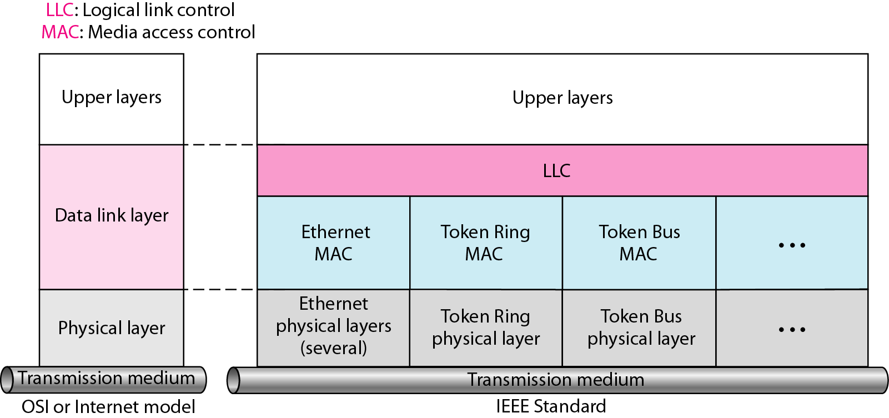
Figure 13.1 IEEE standard for LANs

Slide 62
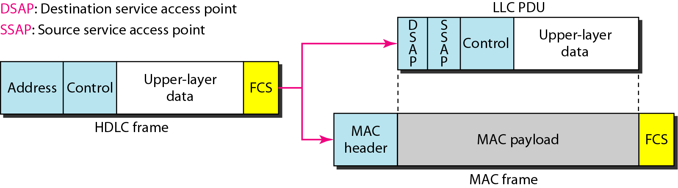
Figure 13.2 HDLC frame compared with LLC and MAC frames

Slide 63
DATA LINK LAYER SWITCHING
Network switching is the process of forwarding data frames or packets from one port to another leading to data transmission from source to destination. Data link layer is the second layer of the Open System Interconnections (OSI) model whose function is to divide the stream of bits from physical layer into data frames and transmit the frames according to switching requirements. Switching in data link layer is done by network devices called bridges.
.

Slide 64
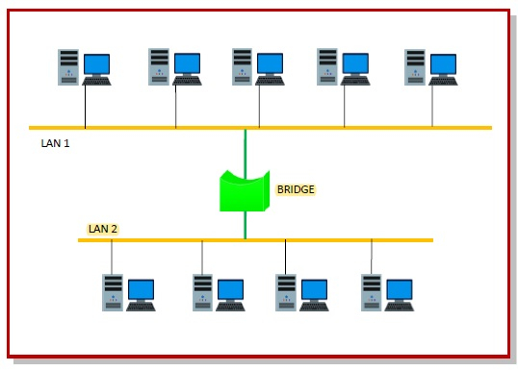
Bridges
A data link layer bridge connects multiple LANs (local area networks) together to form a larger LAN. This process of aggregating networks is called network bridging. A bridge connects the different components so that they appear as parts of a single network.
The following diagram shows connection by a bridge −

Slide 65
Switching by Bridges
When a data frame arrives at a particular port of a bridge, the bridge examines the frame’s data link address, or more specifically, the MAC address. If the destination address as well as the required switching is valid, the bridge sends the frame to the destined port. Otherwise, the frame is discarded.
The bridge is not responsible for end to end data transfer. It is concerned with transmitting the data frame from one hop to the next. Hence, they do not examine the payload field of the frame. Due to this, they can help in switching any kind of packets from the network layer above.
Bridges also connect virtual LANs (VLANs) to make a larger VLAN.
If any segment of the bridged network is wireless, a wireless bridge is used to perform the switching.

Slide 66
Types of Bridges
There are three main ways for bridging −
simple bridging
multi-port bridging
learning or transparent bridging

Slide 67
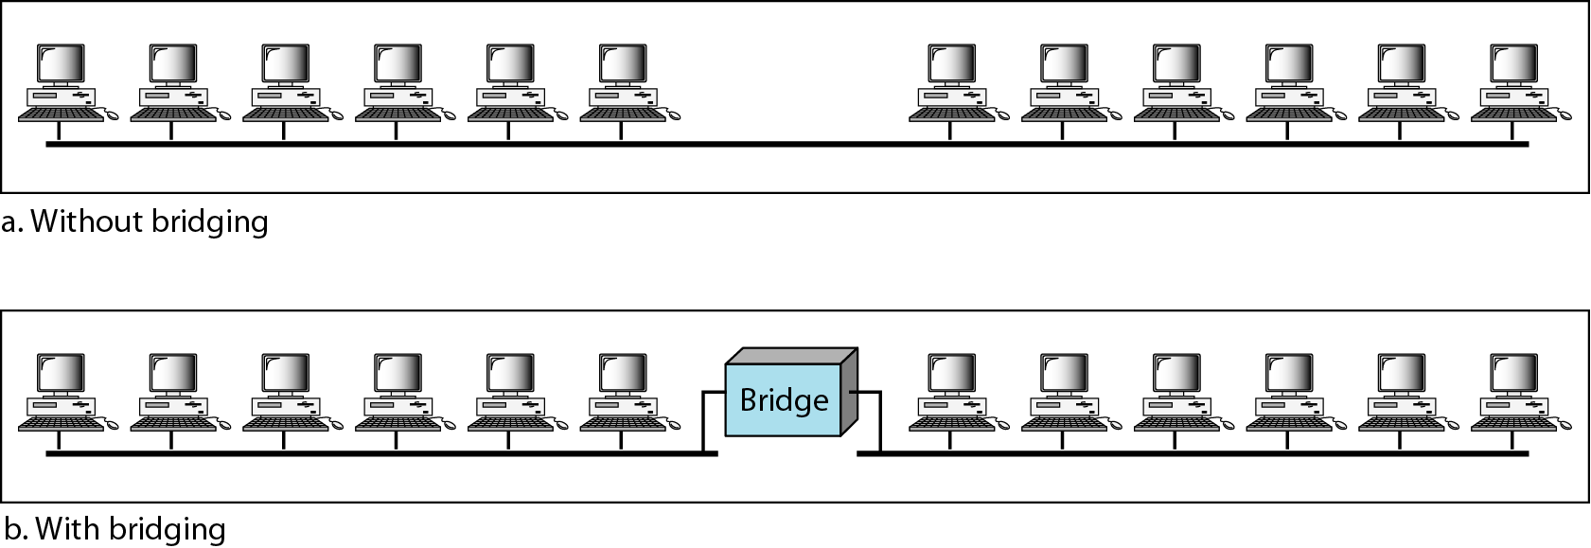
Figure 13.15 A network with and without a bridge

Slide 68
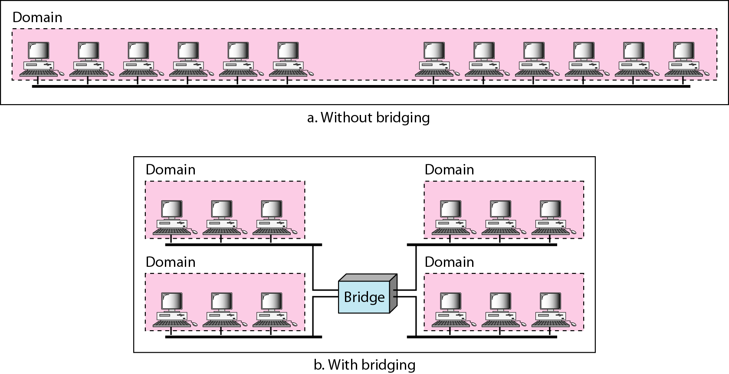
Figure 13.16 Collision domains in an unbridged network and a bridged network

Slide 69
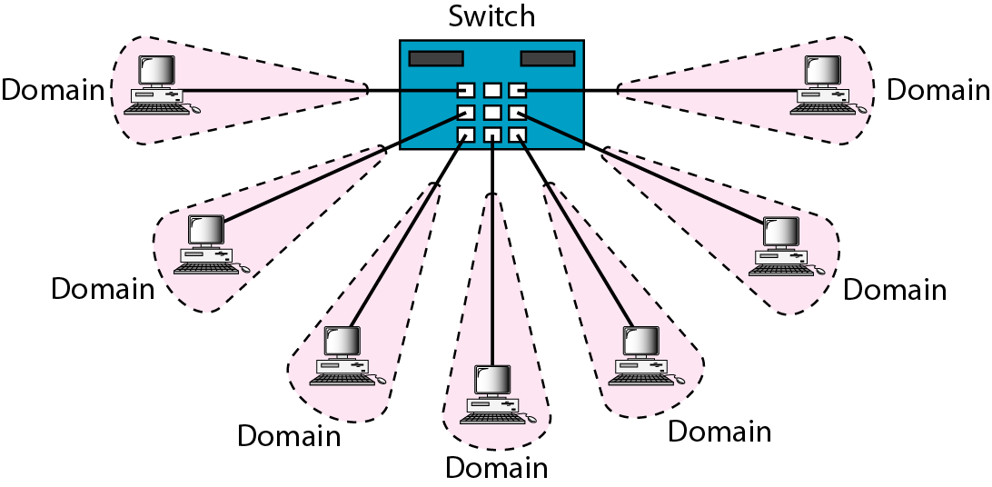
Figure 13.17 Switched Ethernet

Slide 70
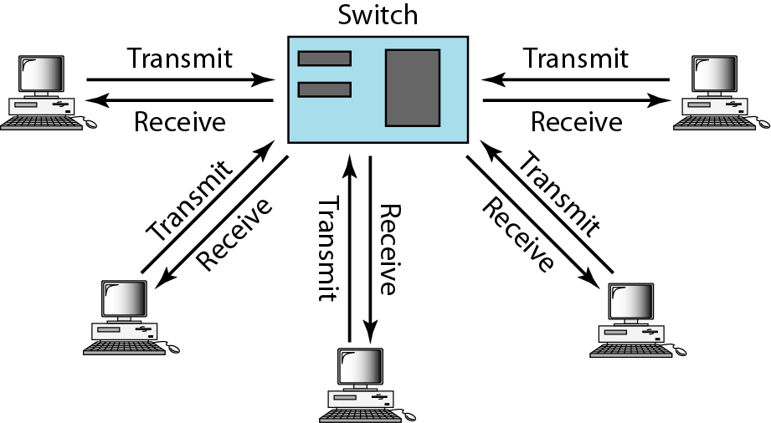
Figure 13.18 Full-duplex switched Ethernet

Slide 71

Chapter 14
Wireless LANs
Copyright © The McGraw-Hill Companies, Inc. Permission required for reproduction or display.

Slide 72
14-1 IEEE 802.11
IEEE has defined the specifications for a wireless LAN, called IEEE 802.11, which covers the physical and data link layers.
Topics discussed in this section:
Architecture MAC Sublayer
Physical Layer

Slide 73
Note
A BSS without an AP is called an ad hoc network;
a BSS with an AP is called an infrastructure network.

Slide 74
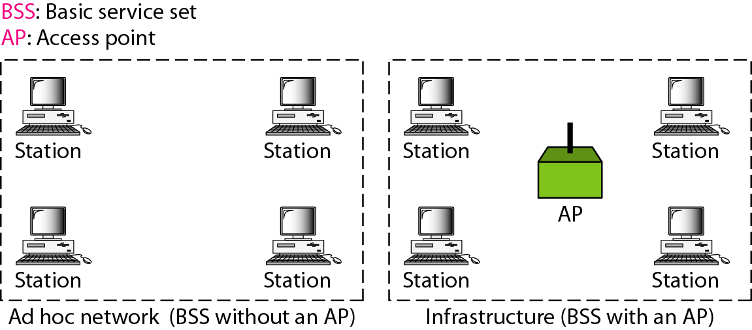
Figure 14.1 Basic service sets (BSSs)

Slide 75
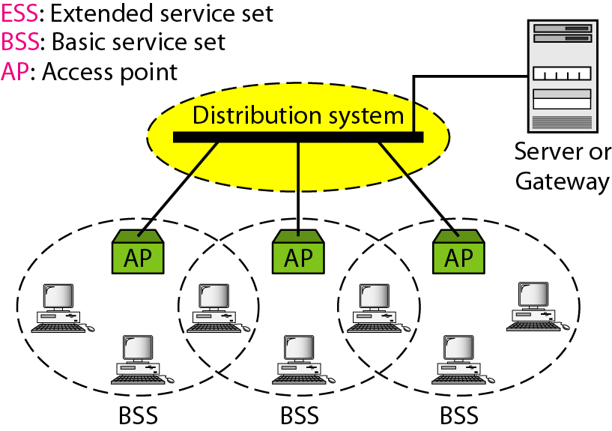
Figure 14.2 Extended service sets (ESSs)

Slide 76
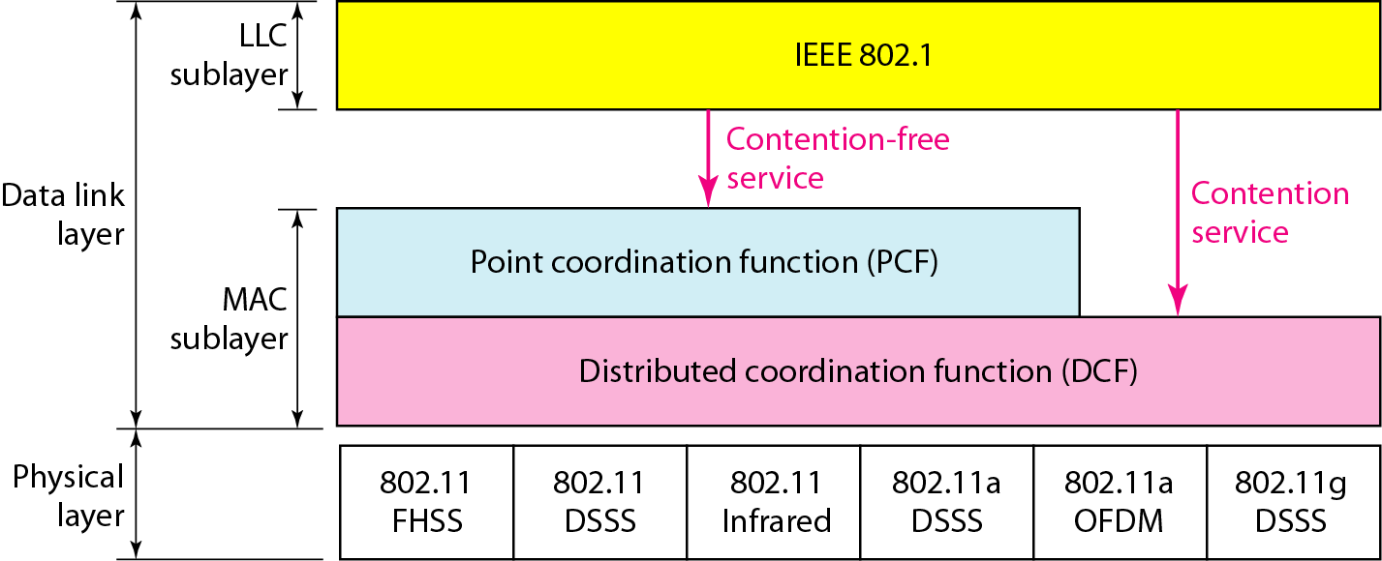
Figure 14.3 MAC layers in IEEE 802.11 standard

Slide 77
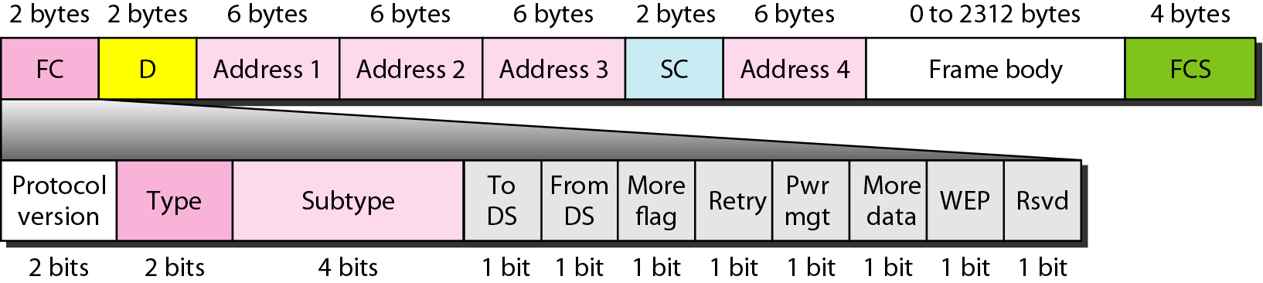
Figure 14.7 Frame format

Slide 78
14-2 BLUETOOTH
Bluetooth is a wireless LAN technology designed to connect devices of different functions such as telephones, notebooks, computers, cameras, printers, coffee makers, and so on. A Bluetooth LAN is an ad hoc network, which means that the network is formed spontaneously.
Topics discussed in this section:
Architecture Bluetooth Layers Baseband Layer
L2CAP

Slide 79
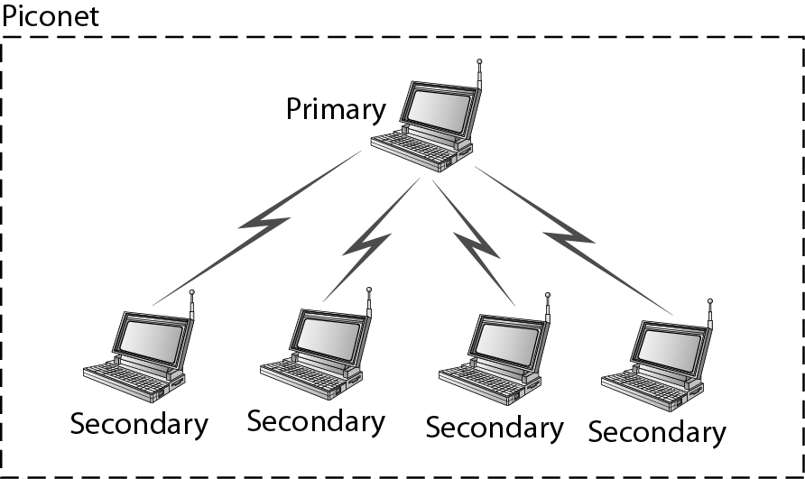
Figure 14.19 Piconet

Slide 80
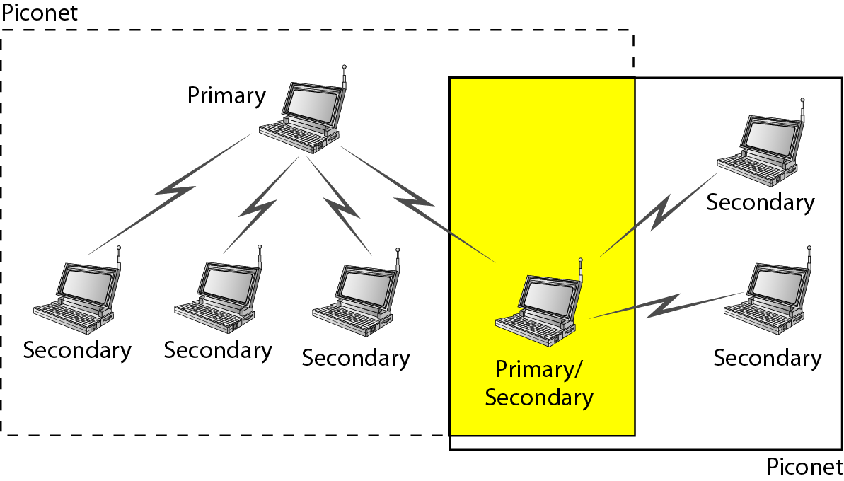
Figure 14.20 Scatternet

Slide 81
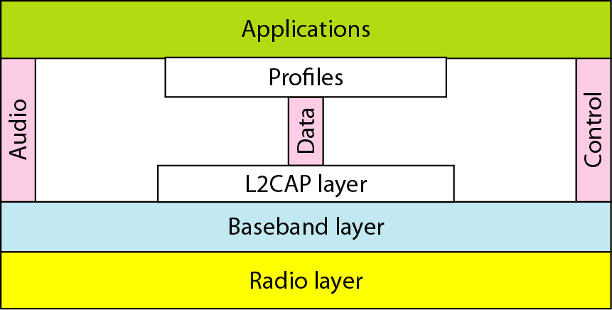
Figure 14.21 Bluetooth layers

Slide 82
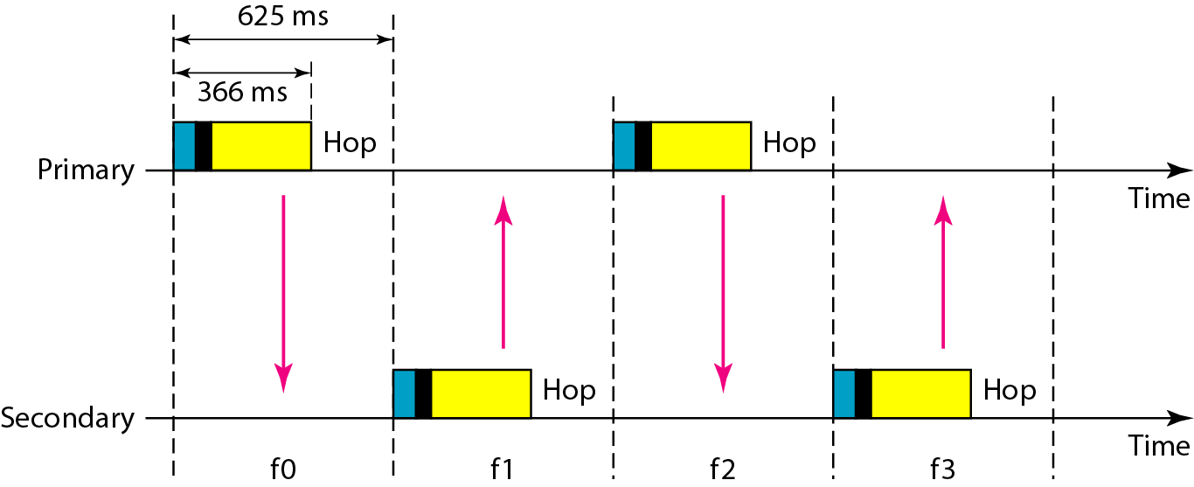
Figure 14.22 Single-secondary communication

Slide 83

Figure 14.23 Multiple-secondary communication

Slide 84

Figure 14.24 Frame format types

Slide 85

Figure 14.25 L2CAP data packet format

